Slide 1
基於Infineon XMC1302-Q024的直流無刷馬達控制之工業用輸送機馬達方案 – 測試報告 2019.10.16

Slide 2
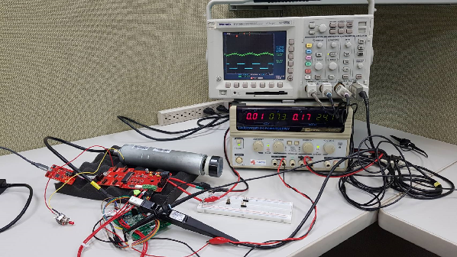
Test Environment
Driver board: IFX_XMC_PMSM_LV_EVK
Motor type: BLDC motor of conveyor belt
S/W control method: 120deg block commutation with pwm
Position detection: 3 Hall sensor
Speed control scheme: Potentiometer 0~5Vdc
Free loading

Slide 3
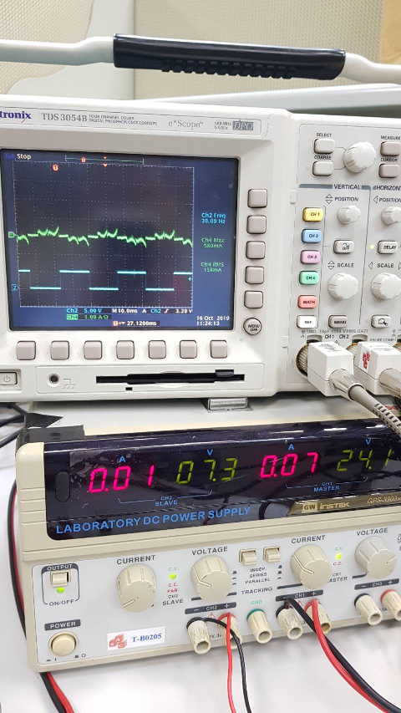
Motor operation
1000RPM
24V Input
0.15A
3.6W

Slide 4
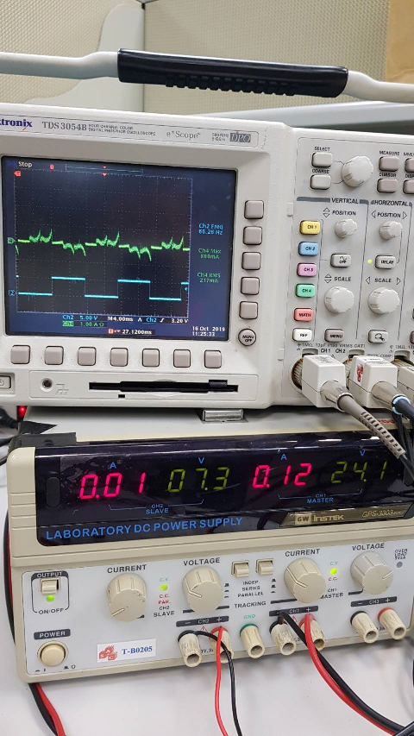
Motor operation
2000RPM
24V Input
0.21A
5W

Slide 5
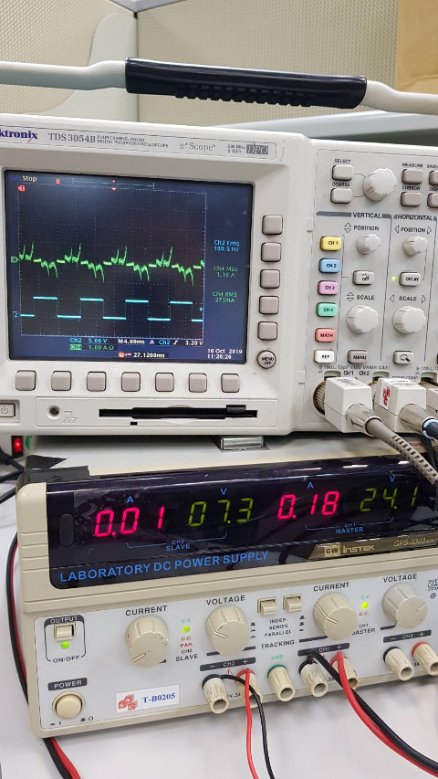
Motor operation
3000RPM
24V Input
0.27A
6.5W

Slide 6
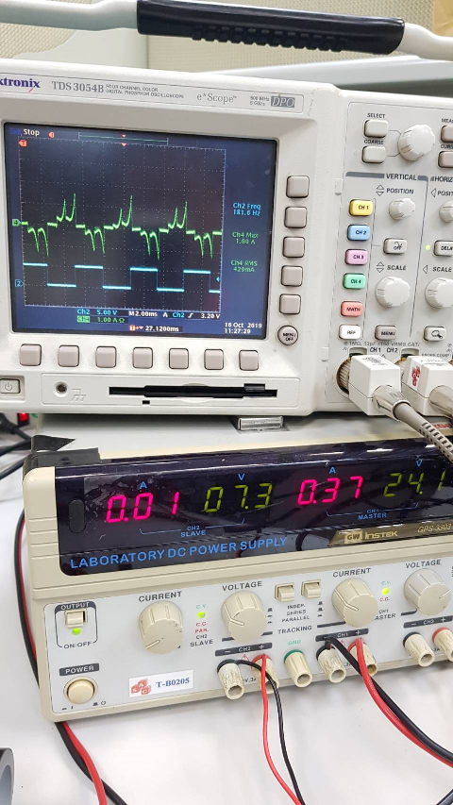
Motor operation
Max 5440RPM
24V Input
0.43A
10.3W

Slide 7
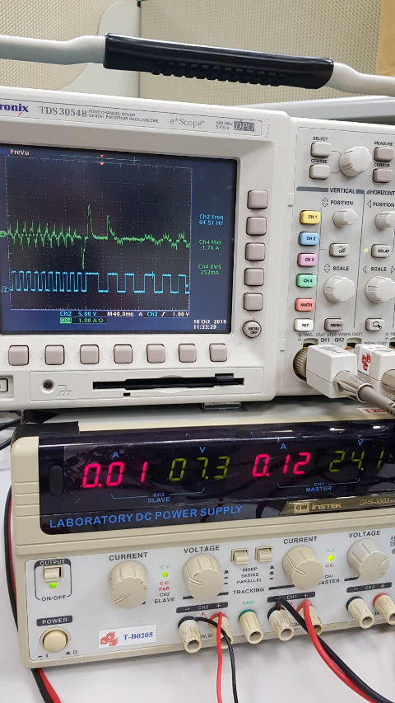
Motor bidirection
P.2.2-ADC detection
5V: CW
0V: CCW

Slide 8
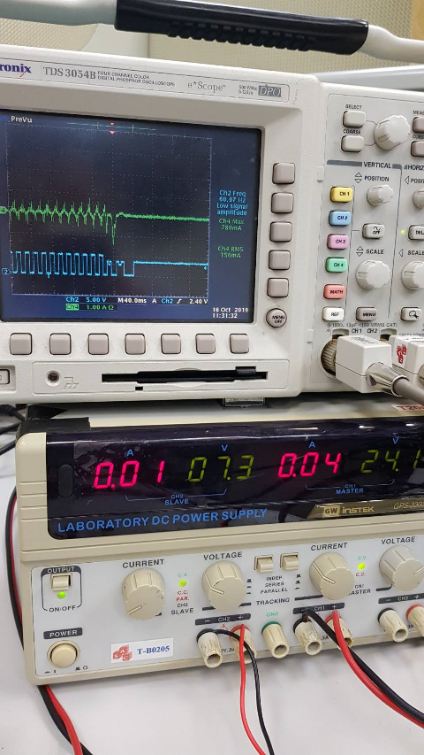
Motor break
Method1:
Singal phase to phase
continues to open
(ex. HV to LW)
Method2:
UVW Low side turn on
UVW High side turn off

